Slide 1

Bayesian Inference and Modeling using Factor Graphs
Under Supervision of
Eng. Mohamed Hammad

Slide 2
AGENDA
Why Probabilistic Programming
Probabilistic Graphical Models
PGM Representation
Factor Graphs
Bayesian Inference
Belief and Expectation Propagation
Infer.Net and Editor

Slide 3
Probabilistic programming vs. traditional ML and Neural Networks
Machine Learning:
Given the data, your objective is to find best model that can generalize well.
You feed in the data to the model, learn the parameters from data and then use it to make predictions.
Data must be sufficient in order to learn the model parameters.
Probabilistic Programming:
Strong domain knowledge by injecting prior beliefs about the dynamics that you are trying to model
update prior beliefs based on data you have observed
High model interpretation
outputs the uncertainties in the data and model

Slide 4
Probabilistic Graphical Models
Motivation
Medical Diagnosing System
Predisposing factors
Symptoms
Results of various tests
Possible diseases
Model
Treatment
uncertainty

Slide 5
Probabilistic:
Deal with large amounts of uncertainty due to:
partial knowledge of the state of the world
noisy observations
modeling limitations
Graphical:
To provide both an intuitively appealing interface by which humans can model highly-interacting sets of variables.
Model:
Declarative representation of our understanding of the world and how the variables interact with each other.
Same model or same representation can then be used in the context of one algorithm that answers any one kind of question
Notes:
Probabilistic is in there because these models are designed to help us deal with large amounts of uncertainty. So uncertainty comes in many forms and for many different reasons:
1- partial knowledge of the state of the world, for example the doctor doesn't get to measure every symptom or every test result and uncertain about the diseases that the patient has.
2- noisy observations
3- modeling limitations, so we're going to have phenomena that are just not covered by our model.
Model:
declarative representation of our understanding of the world. So it is a representation within the computer that captures our understanding of what these variables are and how they interact with each other.
declarative means that we can look into it and make sense of it. So,

Slide 6
Goal
Capture our uncertainty about the possible states of the world in terms of their probability distribution or what's called a joint distribution over the possible assignments to the set of random variables.
Random Variables: X1,...,Xn
Joint Distribution: P(X1,...,Xn)
If we have N binary random variables, P(X1, . . . , XN ) needs O(2**N ) parameters

Slide 7
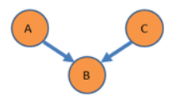
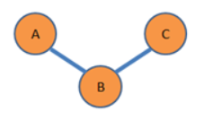
Representation
Graphical models classes:
The nodes are the random variables in our domain
The edges correspond, intuitively, to direct influence of one node on another
Bayesian Networks
Directed Acyclic Graph (DAG)
Markov Networks
Undirected Graphical Models

Slide 8
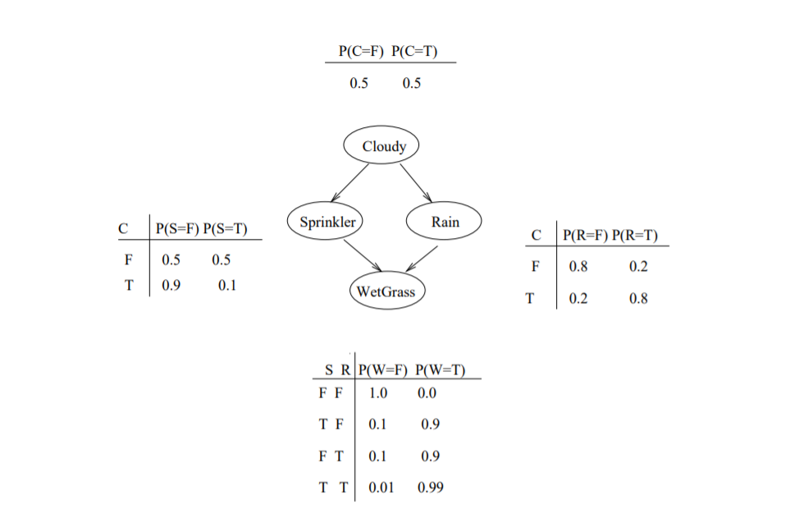
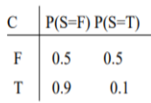
Bayesian Networks
Example:
Nodes: binary random variables
Arc from A to B: A “causes” B
Each random variable in the network has an associated conditional probability distribution (CPD)
CPDs capture the conditional probability of the random variable, given its parents in the graph
P(W = true|S = true, R = false) = 0.9

Slide 9
Summary
Bayesian Networks are Visual design tool to graphically represent and inspect properties of joint probability distributions that has strengths in scientific modeling for encoding structured knowledge
Goal
Due to the complicated relationships between variables, we need a universal representation of relationships not just by connection lines
Language that has explicit role for functions (functional relationships) that are not just represented as lines

Slide 10
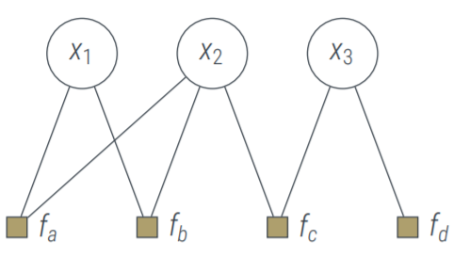
Factor Graphs
Idea:
Represent factorization of a probability distribution function, enabling efficient computations, such as the computation of marginal distributions through the sum-product algorithm.
Bipartite Graph
Two sets of variables: Variables and Factors
G = (V, F, E) V: Variables F: Factors E: Edges
Edges connect nodes of two different types

Slide 11
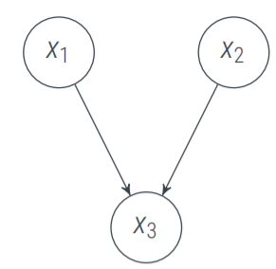
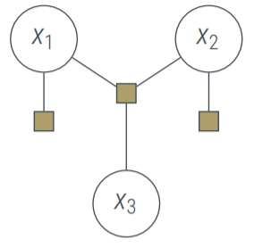
Factor graph from a directed graph:
For each variable draw a circle
For each children and parent just draw one factor node
Connect them

Slide 12

Bayesian Inference:
Is a method of statistical inference in which Bayes' theorem is used to update the probability for a hypothesis as more evidence or information becomes available
For different values of hypothesis, only the factors Likelihood P(B│A) and Prior probability P(A), both in the numerator, affect the value of the posterior probability P(A│B)
Where P (B) = ∫ P (B│A) P (A) d(A) is constant for all parameters.

Slide 13
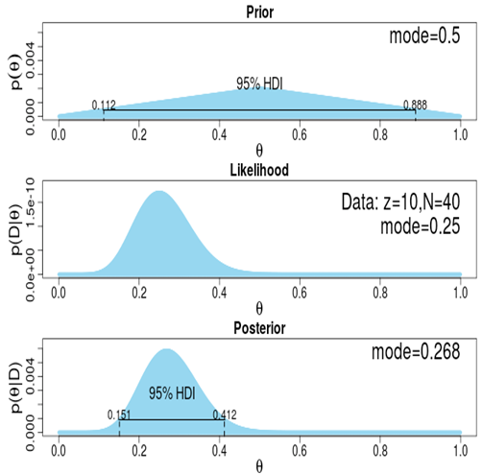
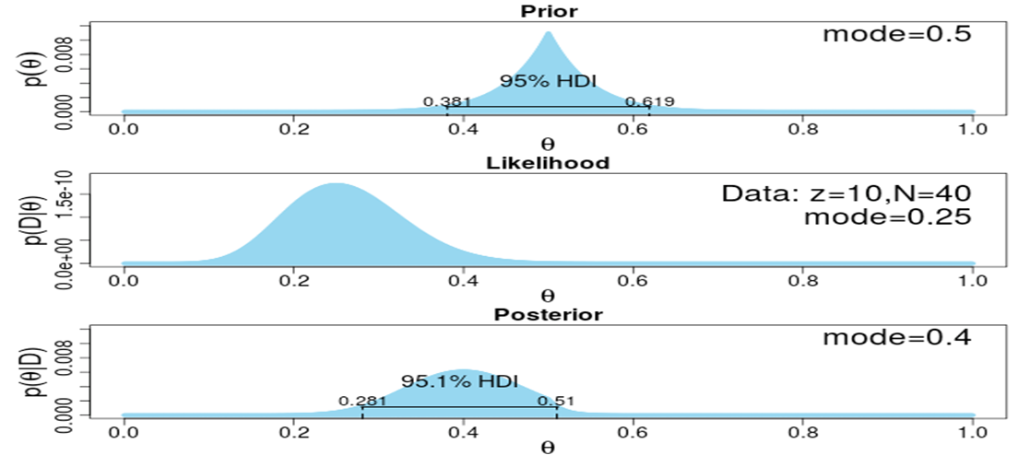
Why Bayesian approach not frequentist method?

Slide 14
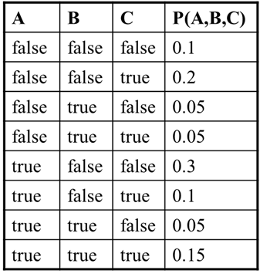
The Joint Probability Distribution
Using the chain rule of probability:
P(A,B,C) = P(A|B,C)P(B|C)P(C)
Joint probabilities can be between any number of variables, eg. P(A = true, B = true, C = true)
For each combination of variables, we need to say how probable that combination is.
Lots of entries in the table to fill up!
For k Boolean random variables, you need a table of size 2^k

Slide 15
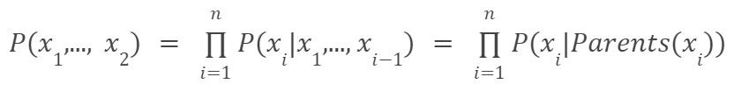
Naive Approach:
States that each node is conditionally independent of its non-descendants given its parents. In the below example, this means that:
This property allows us to simplify the joint distribution, obtained in the previous section using the chain rule, to a smaller form.

Slide 16


Marginal inference
Is the probability of a given variable in our model after we sum everything else out.
The inference task, is to find P(x|e), In the above example, an example of this could be to find P(Sprinkler, WetGrass | Cloudy), where {Sprinkler, Wet Grass} is our x, and {Cloudy} is our e. In order to calculate this, we use the fact that
Where α is a normalization constant. In order to calculate P(x, e), we must marginalize the joint probability distribution over the variables that do not appear in x or e, which we will denote as Y.

Slide 17
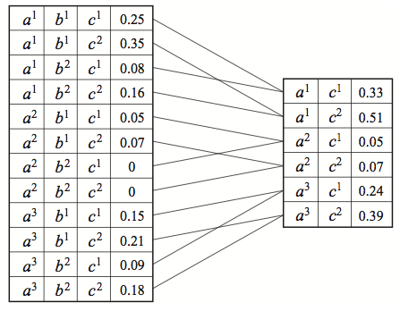

Marginal inference
It turns out that inference is a challenging task.
For many probabilities of interest, it is NP-hard to answer any of these questions exactly.

Slide 18
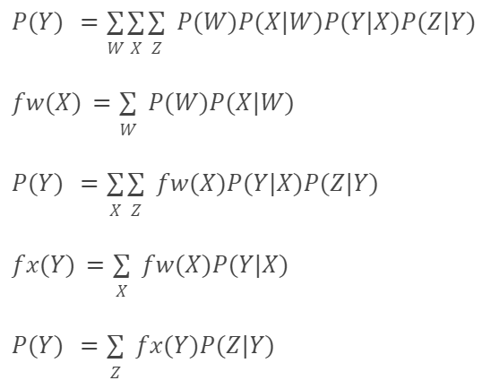
Variable elimination
W
X
Y
Z

Slide 19
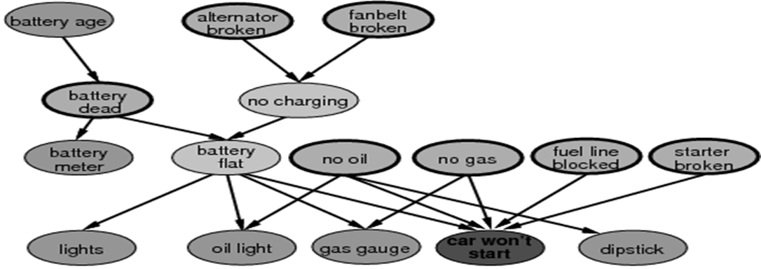
Alternative Methods:
Many networks are too large even for this method,
so approximate inference methods such as MCMC and expectation propagation are instead used;
these provide probability estimations that require significantly less computation than exact inference methods.
Belief propagation is another exact inference that can be used.

Slide 20
The Sum-Product Algorithm
The Sum-Product-Algorithm unifies many historically separate ideas, one of them is machine learning: used for inference in Bayesian networks.
Exact inference method that makes use of the distributive property of addition: ab + ac = a(b + c).

Slide 21
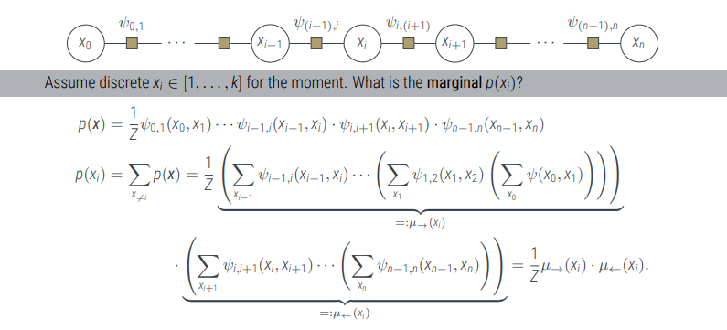
Base Case: Markov Chains

Slide 22
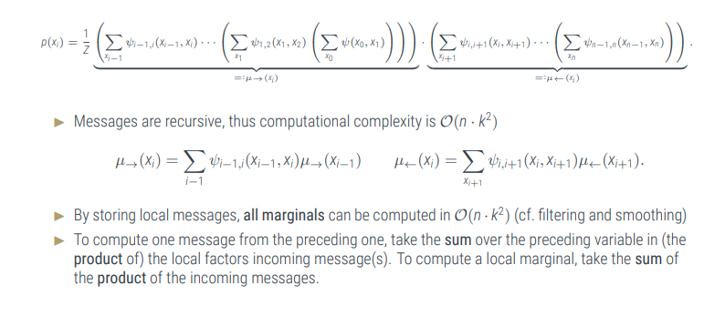
Base Case: Markov Chain (cont’d)

Slide 23
Belief Propagation
Exact Inference Algorithm that works on directed graphs without loops.
It’s equivalent to a special case of the sum-product algorithm.

Slide 24
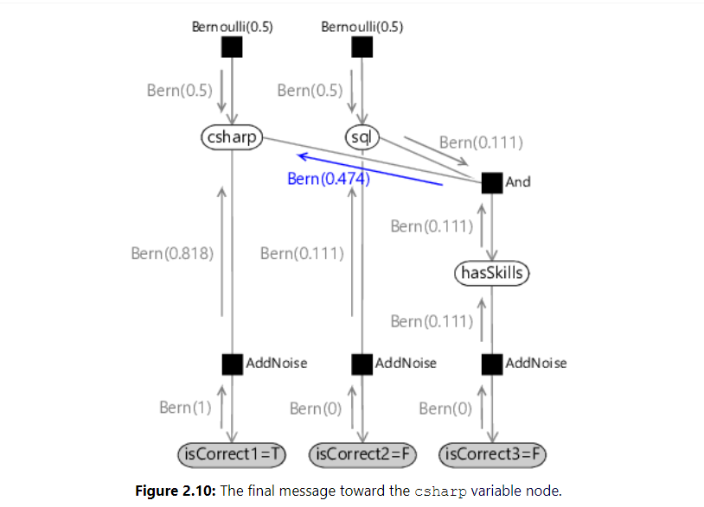
Message Passing On A Factor Graph:

Slide 25
Intractable Messages
In practice, there are problems with observations having complicated distribution (e.g. mixture of models), and therefore messages are intractable.
One of the solutions is to approximate the true complicated distribution to a family of simpler distributions, and then exploring the family to get the most representative one.

Slide 26
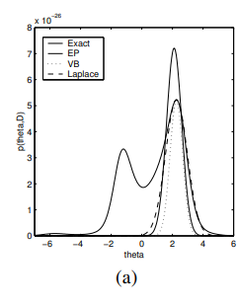
Expectation Propagation
Deals with intractable messages
Handles hybrid networks
Extends belief propagation algorithm by using message passing idea, but this time the messages are approximate gaussians, so what we pass is just 2 parameters (mu, and sigma).

Slide 27
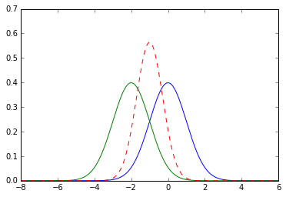
Expectation Propagation (cont’d)
Multiplying gaussians together yields a unimodal, because the tails cancel each other.

Slide 28
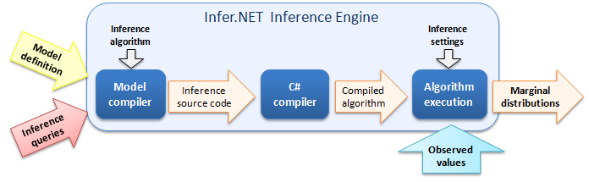
Probabilistic Programming with Infer.NET
Infer.NET is a framework for making Bayesian inference on graphical models.
The user specifies the factors and variables of a graphical model, analyses them and creates a schedule for making inference on the model.
The model can then be queried for marginal distributions.

Slide 29
Probabilistic Programming with Infer.NET (cont’d)
It significantly simplifies the process of implementing probabilistic programming by providing:
The advantage of an API is that you can mix probabilistic and non-probabilistic code, which allows you to embed Infer.NET directly into applications.
An inference engine, which combines the model with your observations, and handles the complex inference process.
Microsoft’s Infer.NET framework can be used from any .NET language, including C++, C#, F#, Visual Basic and IronPython.
Infer.Net uses the Expectation Propagation algorithm.
Notes:
The advantage of an API is that you can mix probabilistic and non-probabilistic code, which allows you to embed Infer.NET directly into applications.
A modelling API which simplifies the creation of probabilistic models.

Slide 30
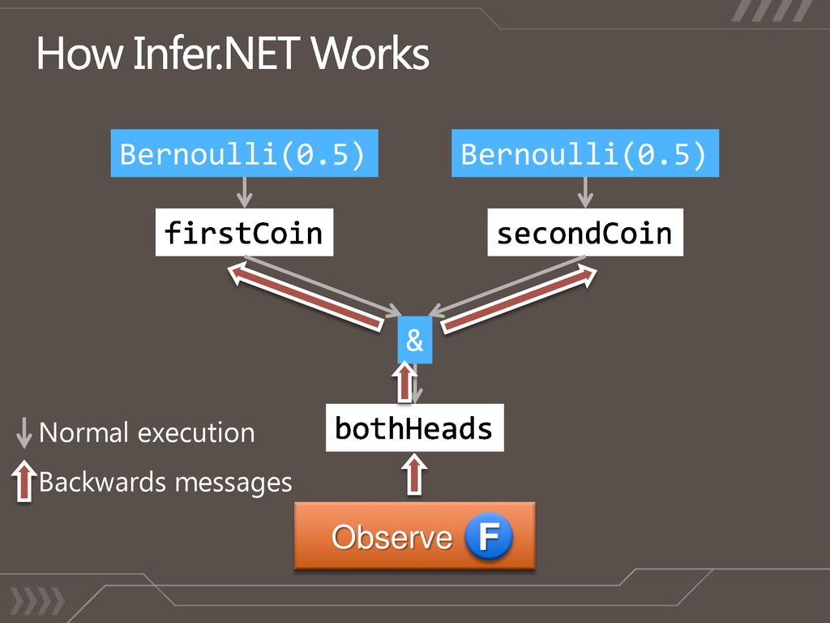
Probabilistic Programming with Infer.NET (cont’d)
The goal of Infer.NET is to allow Machine Learning algorithms to be created in hours instead of several days or weeks.
The flexibility in Infer.NET comes from a rich modelling language that allows complex customized models to be designed and quickly tested.
Inference can work in any direction.
Notes:
Although the generative process has a well-defined direction, inference can work in any direction.

Slide 31
Infer.NET’s Features
Supports continuous as well as discrete variables.
Scalable to large models and large datasets.
Acts as a compiler that converts a model description directly into source code to perform inference with no overhead costs.
Provides multiple algorithms to choose the one suited for your task.
Easy to identify and fix inference problems by its message-passing architecture allows you to use standard tools to step through the inference procedure and examine individual messages.

Slide 32
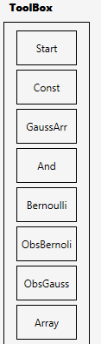



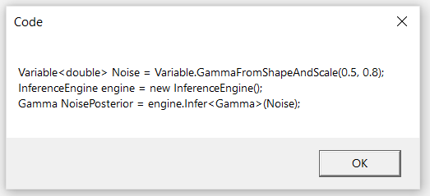
Editor Features and Capabilities
Toolbox contains Nodes for Infer.Net Code.
Factor Nodes after being dragged and dropped dynamically, have two buttons; one for its Property window and the other for removing this node.
Link line connecting nodes dynamically to each other to build the factor graph which reflect to tree structure and the generator traverse this tree depend on node type.
Generate button which generates the infer code from the graph drawn and represent the code on message box.
Remove Button
Property button

Slide 33

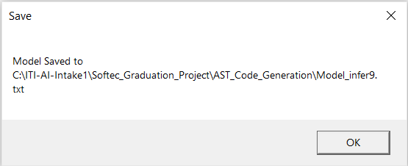

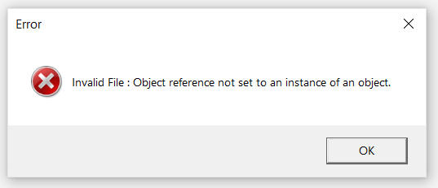
Editor Features and Capabilities (cont’d)
Save button which saves the model for further usage as .xml, .txt or image and has the capability to save multiple ones.
Save Msg which appears to indicate that the model is being saved.
Load button which loads the model after being saved to make any updates for it then generate code or save it again.
Error Msg which appears when file loaded has some issues.
Overall our Editor has limitations on describing all Semantics with limited capabilities.

Slide 34
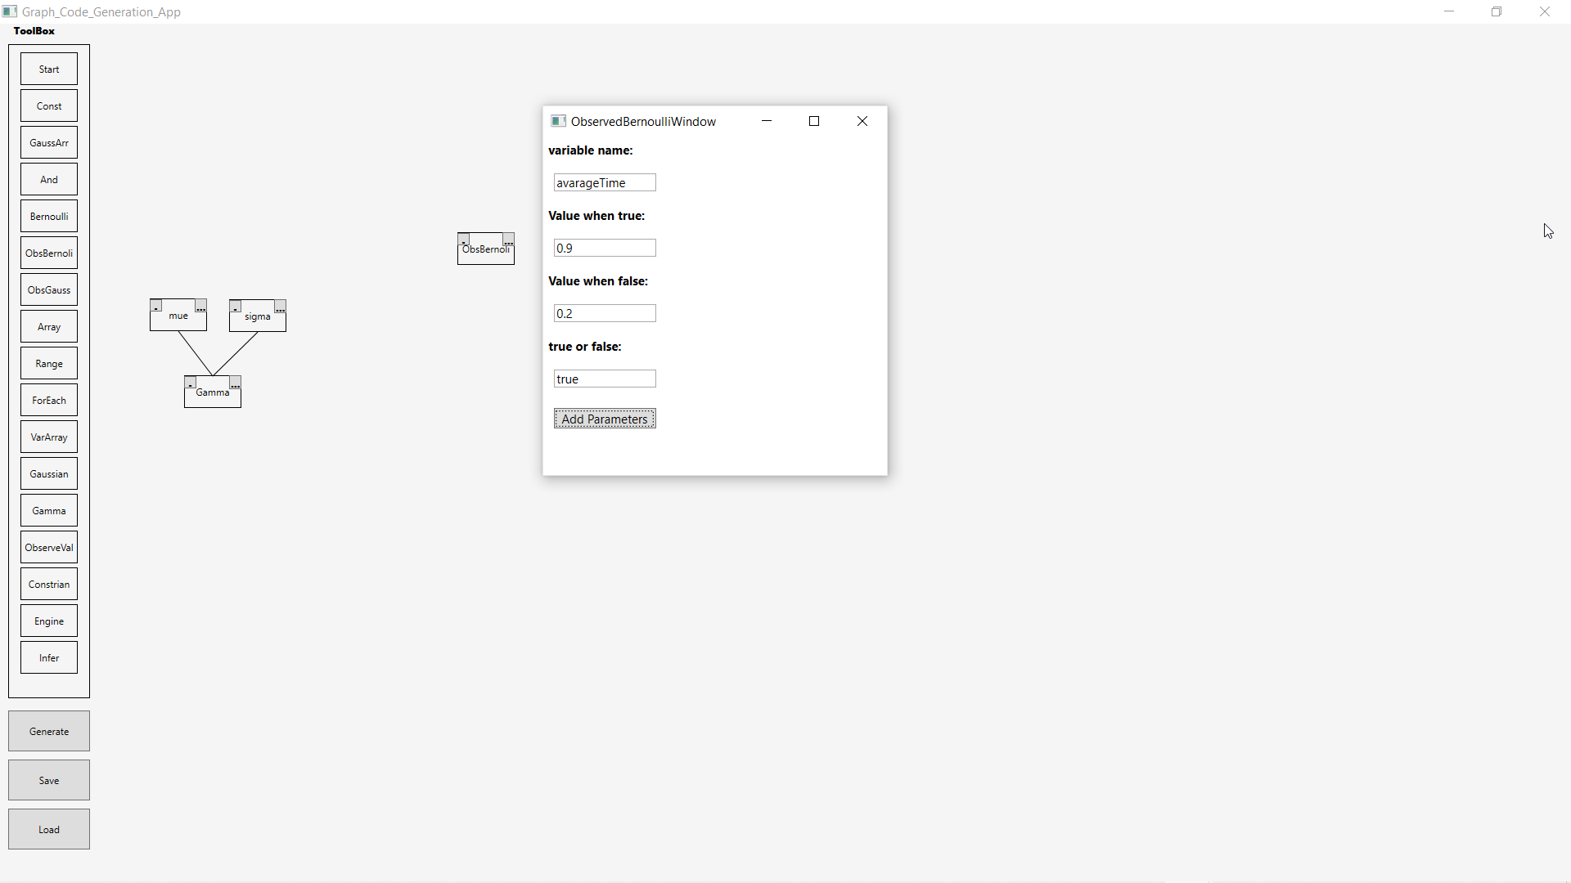
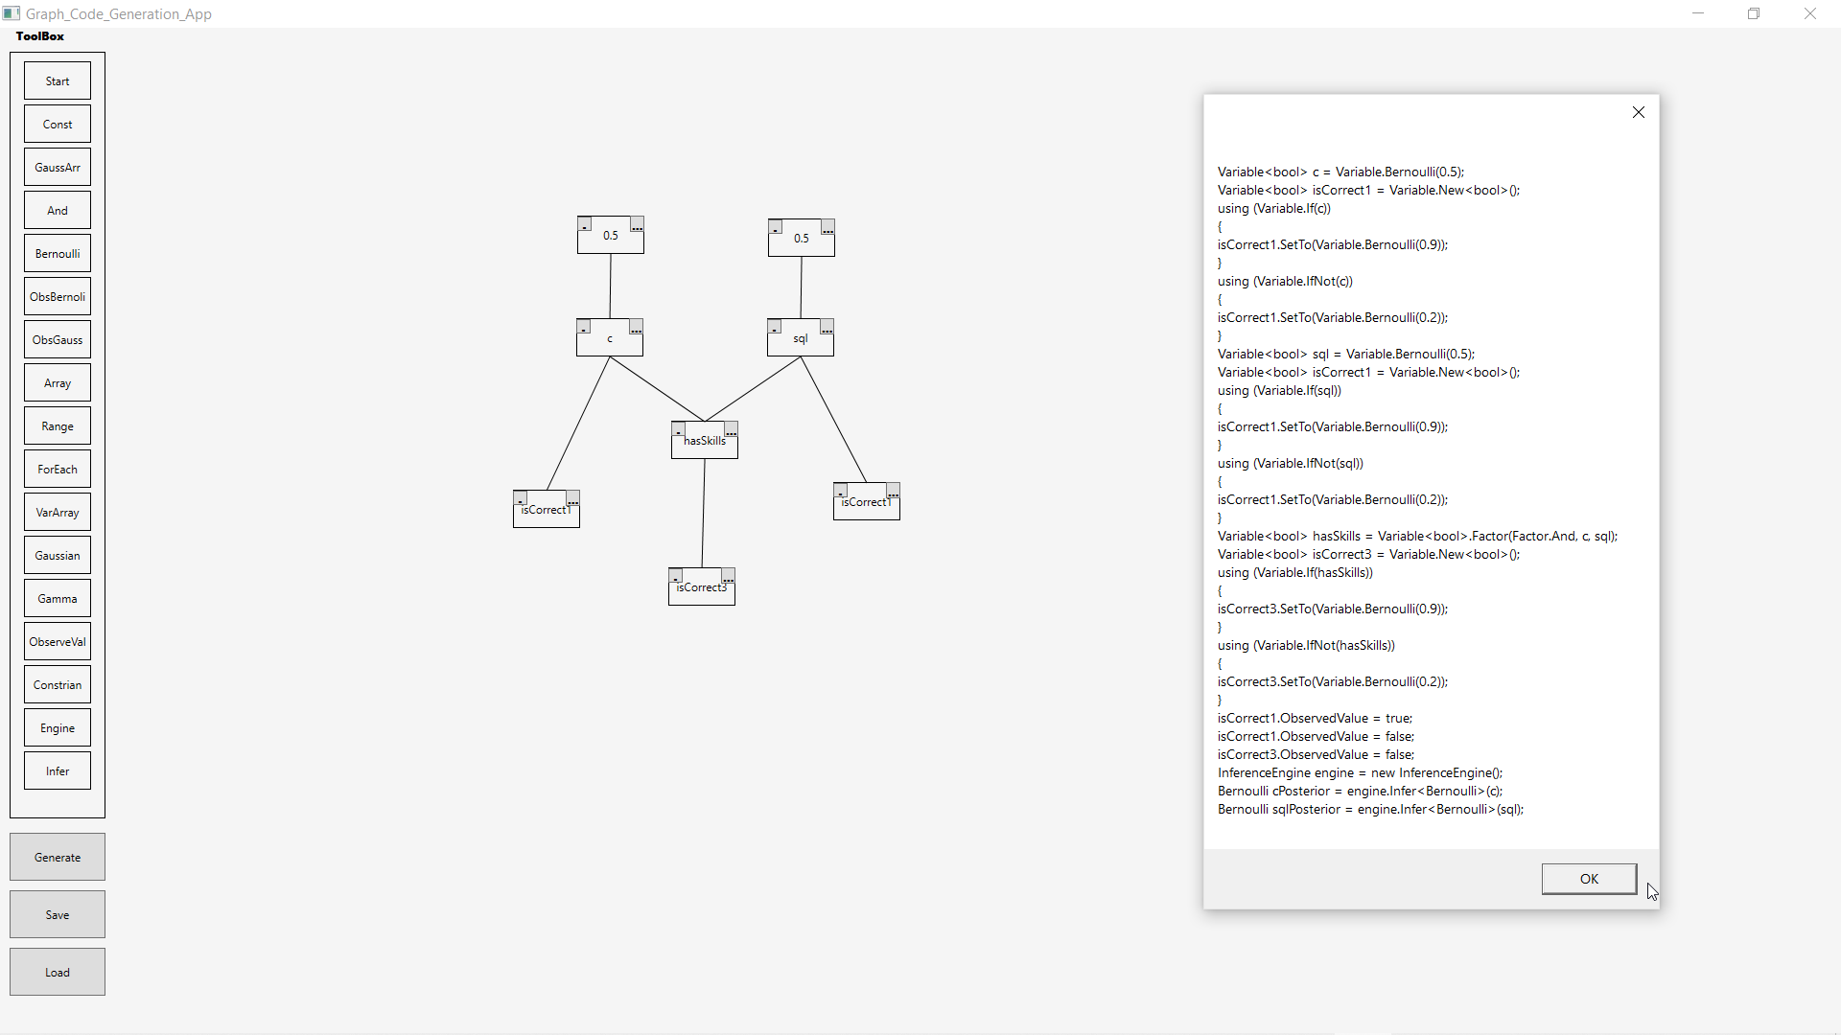
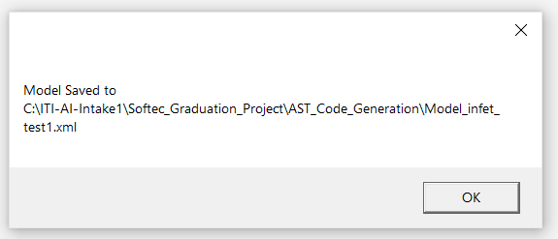
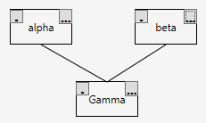
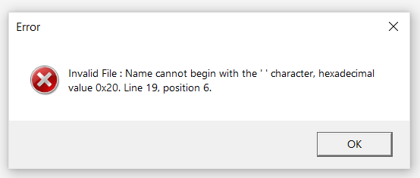

Editor of Graph Code Generation App

Slide 35
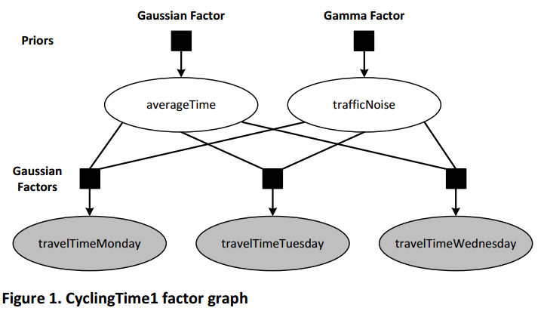
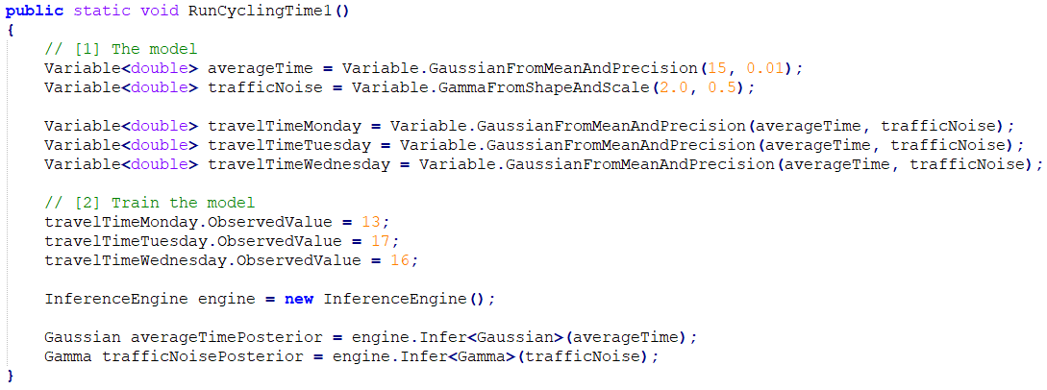
Cycling Time 1 factor graph Problem
Source link: https://dotnet.github.io/infer/InferNet101.pdf

Slide 36
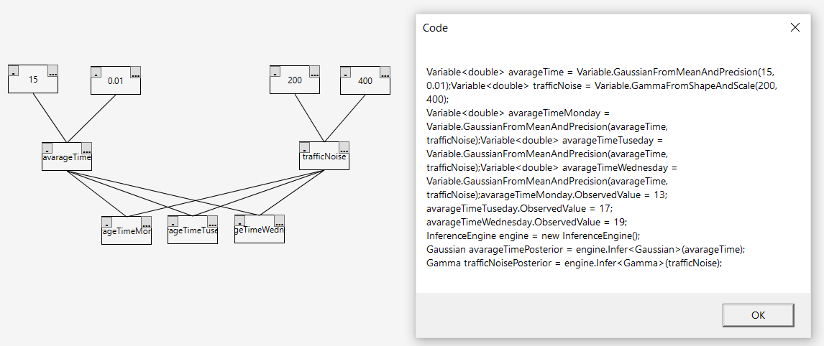
Cycling Time 1 factor graph Problem with our Editor

Slide 37
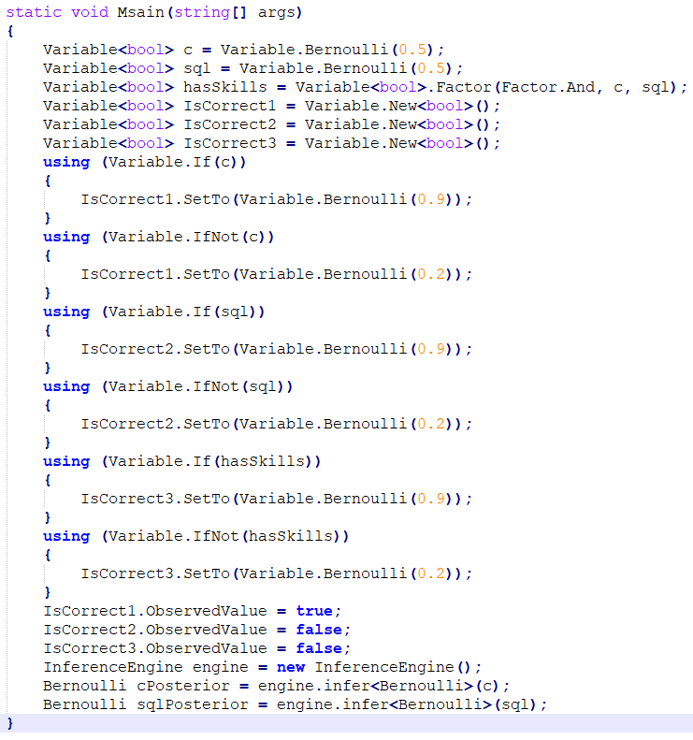
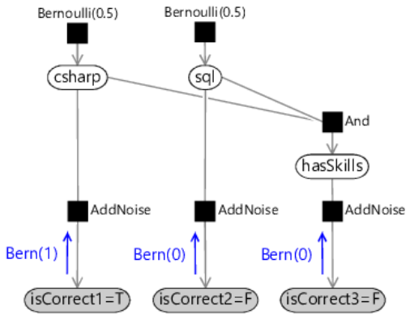
Assessing People’s Skills Problem
Source link: https://www.mbmlbook.com/LearningSkills_Testing_out_the_model.html

Slide 38
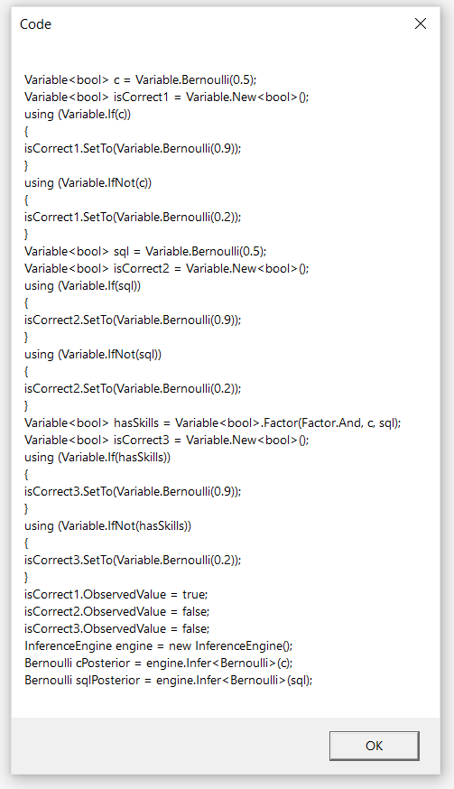
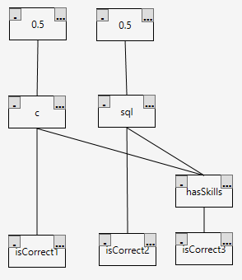
Assessing People’s Skills Problem
with our Editor

Slide 39
CONCLUSION
We took about the following four topics:
Bayesian inference and graph models.
Why we couldn’t apply the naive approach on our problem.
The belief and expectation propagation algorithms.
The infer.net and our editor desktop application with limited semantics.
Future Work:
Make our Editor application valid for all semantics.

Slide 40


Slide 41
Team Members
Lamyaa zayed Peter Potros
Mohamed Mostafa

